Slide 1

Web Data Science
Military KG Construction
Group: 2 Date: 01/09/2022
Mei Zhibiao, Li Changmin,
Wang Zhengyu, Mao Yehao, Cao Yanting

Slide 2
目 录
CONTENTS
03
01
02
04
Introduction
Procedure
How to build a knowledge Graph
Application
Relevant knowledge
Task Requirement
Structure
Project Structure
Data Composition

Slide 3
01
Introduction
Knowledge Graph
Process
Background
Task

Slide 4
Knowledge Graph
Knowledge
Representation
Knowledge Reasoning
Complement reasoning
Prediction of relation
Detection of model
Prediction and reasoning
Vector representation
Symbolic representation
Knowledge Acquisition
Multimedia
Unstructured Date
Structured Data
Crowd
Knowledge Searching
Concept extraction
Entity extraction
Relation extraction
Rule extraction
Semantic search
Query and Storage
Intelligent Q&A
Knowledge Fusion
Knowledge Analysis
Entity alignment
Entity diasmbiguation
Ontology alignment
Data analysis
Visualization
Explanation of model
Field of application
E-commerce; Medicine; Military; Finance…

Slide 5
Background
The military field is a field with high sensitivity and confidentiality coefficient, and its data value is very high. It is of strategic significance to obtain relevant military data and provide a convenient way of human-computer interaction. Military equipment information, military base information, and related information between military combat units are organized in the form of maps, which can play an important role in recommending combat strategies and training military personnel.
At present, there are not many public military materials. Therefore, this project selects online public dataset as the knowledge base and uses neo4j to conduct automatic question answering experiments. 。

Slide 6
Constructing a knowledge graph for a specific domain
Intelligent application based on the knowledge graph
– Domain: Military
– Source data: crawling data from Web (>=2 data sources)
– Ontology: knowledge representation, concepts, properties, …
– Knowledge graph:
• knowledge extraction (entity, relations)
• knowledge fusion/integration
• knowledge storage
• knowledge embedding (optional)
– Knowledge graph sizes:
• >100,000 entities
• >1,000,000 triples
– Semantic search
– Question answer
– Visualization (optional)
– Mining and analyzing knowledge graph (optional)
Tasks
INFOGRAPHIC

Slide 7
02
Structure
Project structure
Project data composition

Slide 8
Project Structure：Six Package
Construct
Crawler: data source
01
Construction
Fusion
“spiders”
“get_links”
02
04
Data Storage
Knowledge storage
Data
txt2neo
03

Slide 9
Project Data and Outcomes
8627 entities
02%
108665 triples
01%
03%
8042 Nodes
04%
8139 Relations

Slide 10
03
Procedure
Domain Definition
Data Source Selection
Ontology Construction
Data collection and knowledge extraction
Knowledge Fusion
Knowledge Storage

Slide 11
Domain Definition
Domain definition is an important beginning of the whole project. Because the knowledge graph to be created is military, we define our domain as military.
Starting from military, we expand and identify some specific sub-field including weapon, person, country, R&D unit and war.
11

Slide 12

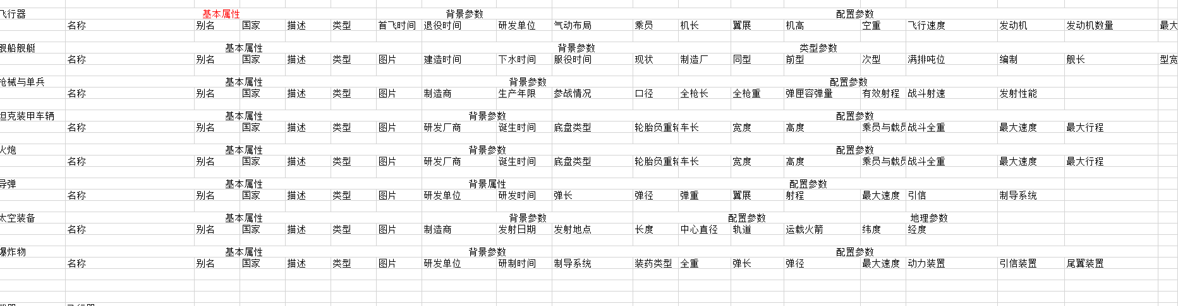
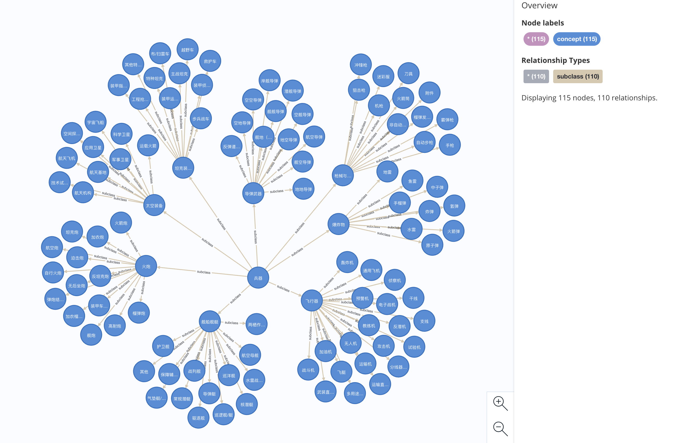
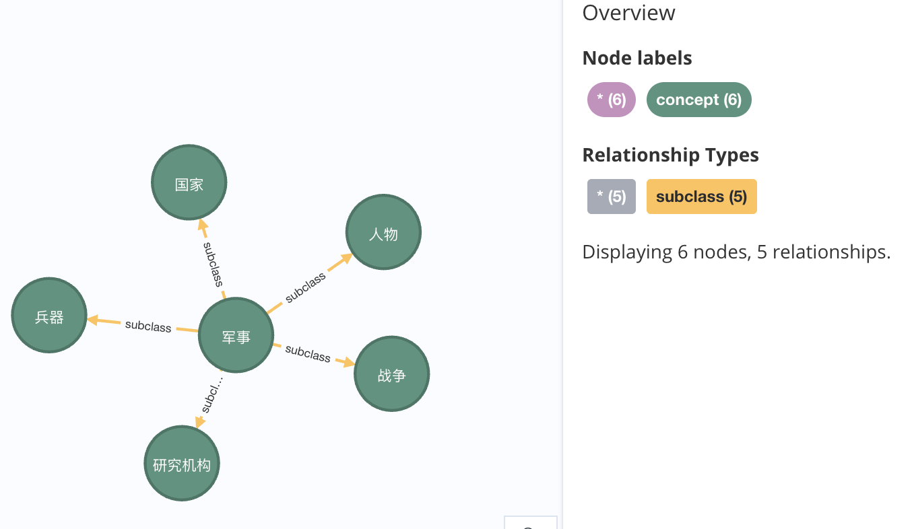

Ontology construction
Top-Concept layer
Sub-Concept layer
Instance layer
select more than ten instance which belong to the same bottom concept and intersect their properties as the final ontology of this kind of instance.

Slide 13

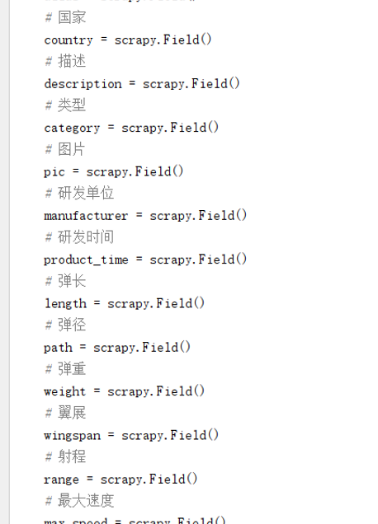
Knowledge representation and knowledge extraction
Schema
01
Item Structure
02
Extract Template
03

Slide 14
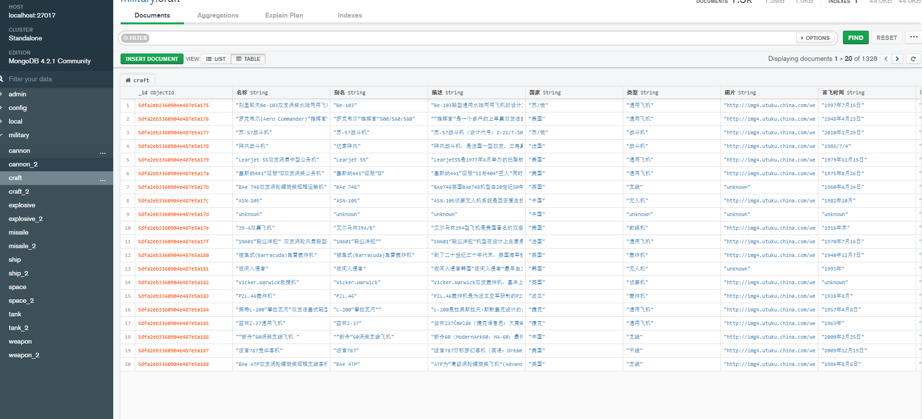
Data collection and knowledge extraction

Slide 15
Knowledge Fusion
Data layer
A
RDF
B
Pattern layer
C
Dictionary
D

Slide 16
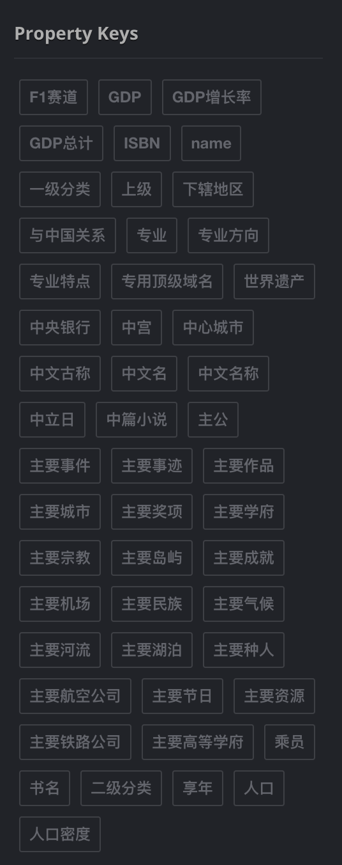
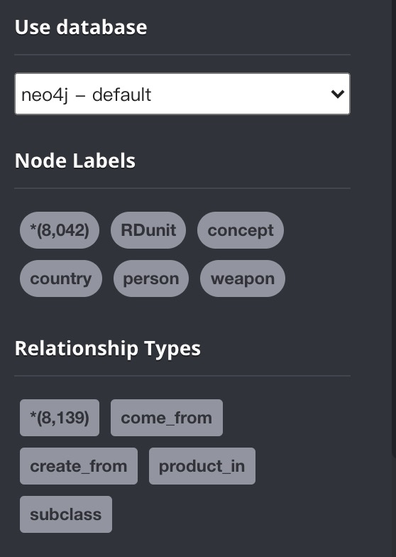
Knowledge Storage
Node Labels
Relationship Types
Property Keys
Data components

Slide 17
04
Application
Visualization
Intelligent Q&A

Slide 18
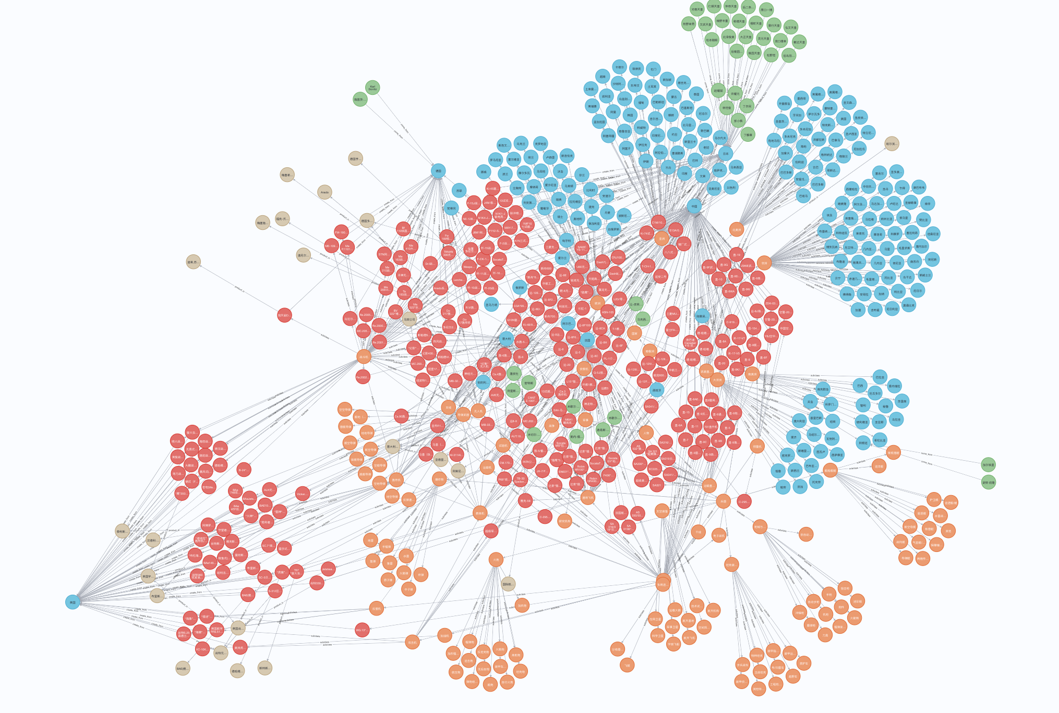
Visualization

Slide 19

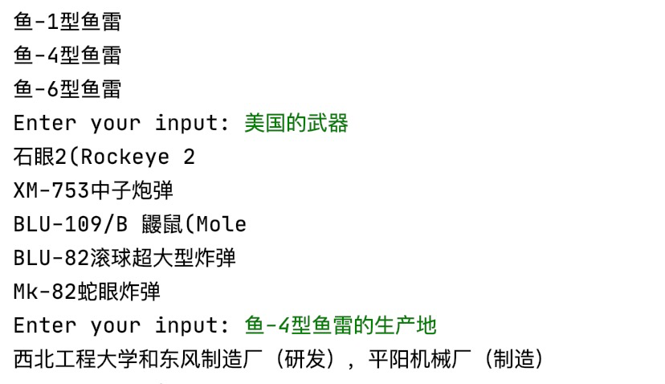
Intelligent Q&A
The user inputs the problem in the operation interface, and the system judges the classification of the problem through different situations
Construct different neo4j query statements for different situations, and then connect to the database for query statements
Get the result of the query, analyze the structure of the result, process the result and output the desired part

Slide 20
Thank you!
Group: 2 Date: 01/09/2022
Teacher: Peng Wang
https://github.com/7NGU/Group2_WDS_Final_report

